Slide 1
Monty Hall Problem
Let’s Make a Deal!

Slide 2
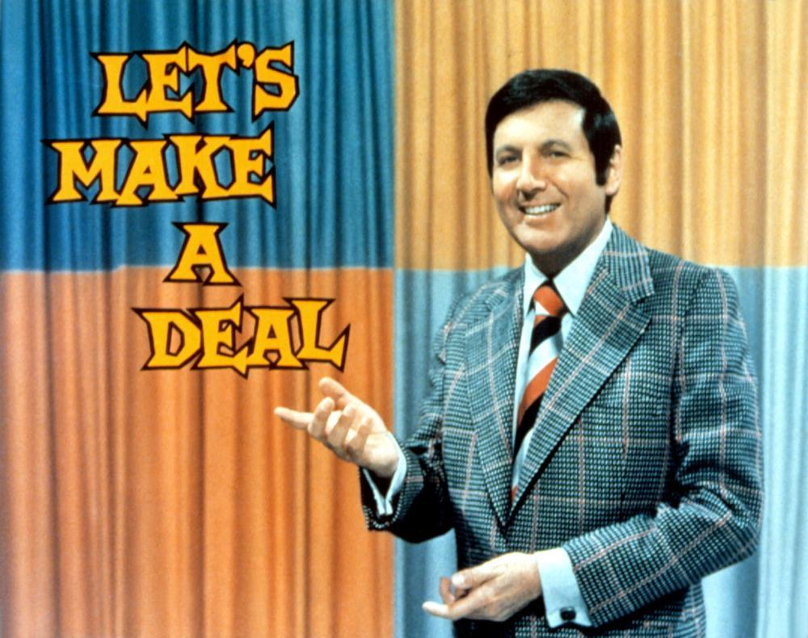
Monty
Hall
Movie “21”:
https://www.youtube.com/watch?v=Zr_xWfThjJ0

Slide 3
Reader’s letter to Ask Marilyn column in the Parade magazine in 1990:
Suppose you're on a game show, and you're given the choice of three doors: Behind one door is a car; behind the others, goats.
You pick a door, say No. 1, and the host, who knows what's behind the doors, opens another door, say No. 3, which has a goat. He then says to you, "Do you want to pick door No. 2?" Is it to your advantage to switch your choice?

Slide 4
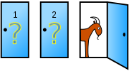
Suppose you're on a game show, and you're given the choice of three doors: Behind one door is a car; behind the others, goats.
You pick a door, say No. 1, and the host, who knows what's behind the doors, opens another door, say No. 3, which has a goat. He then says to you, "Do you want to pick door No. 2?" Is it to your advantage to switch your choice?
Your pick
Take 1-2 minutes to discuss this with the person sitting next to you.

Slide 5
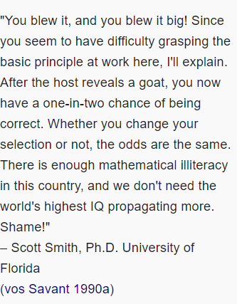
Marilyn vos Savant's response was that the contestant should switch to the other door.
Many readers thought that she was wrong, and she received many letters from angry readers.

Slide 6
She was right! How?
Intuitively, her solution:
Behind door 1 | Behind door 2 | Behind door 3 | Result if staying at door #1 | Result if switching to the door offered
Car | Goat | Goat | Wins car | Wins goat
Goat | Car | Goat | Wins goat | Wins car
Goat | Goat | Car | Wins goat | Wins car

Slide 7
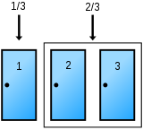
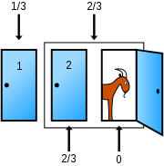
Note: extra info from Monty very important!
Notes:
Car has a 1/3 chance of being behind the player's pick and a 2/3 chance of being behind one of the other two doors.
The host opens a door, the odds for the two sets don't change but the odds move to 0 for the open door and 2/3 closed door.

Slide 8
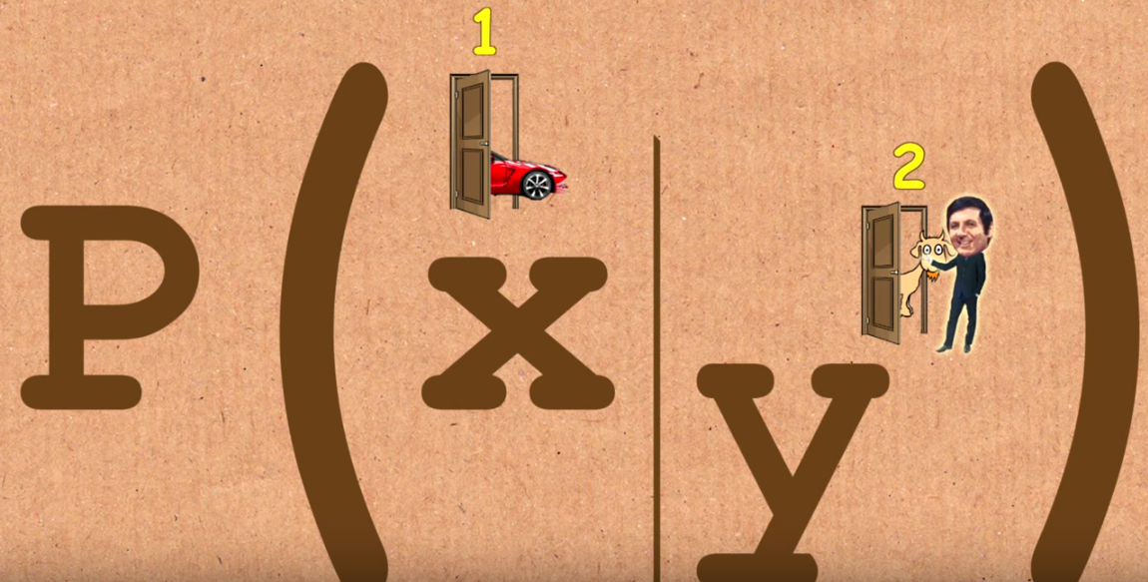
Solution using Conditional Probabilities
Takes into account extra info from Monty:

Slide 9
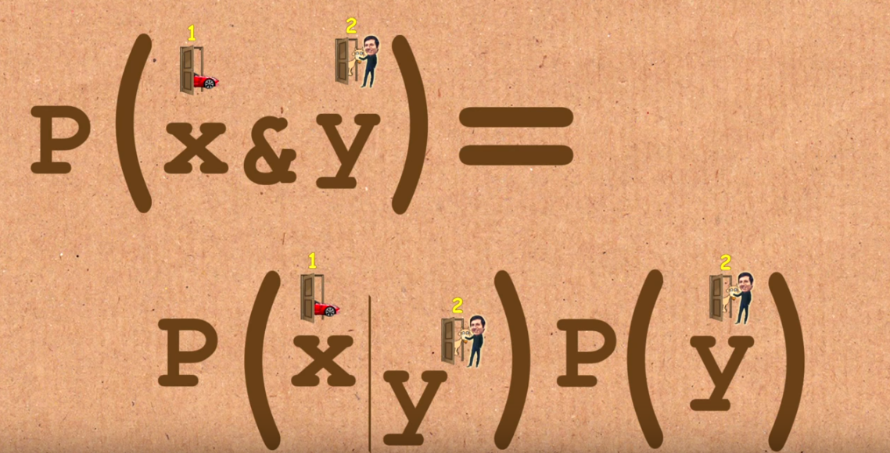


Slide 10
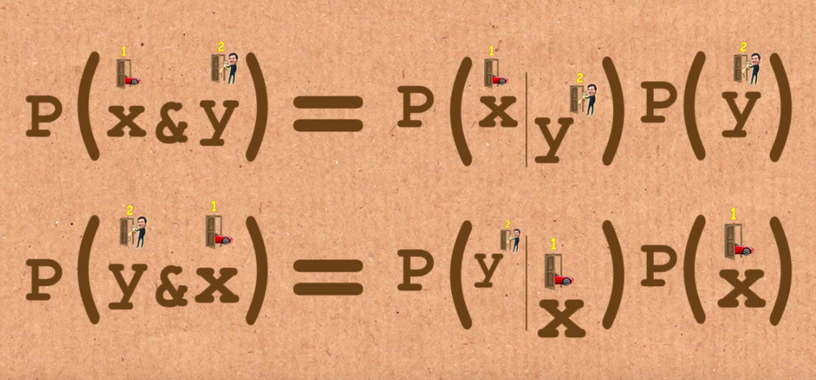
Use symmetry:

Slide 11
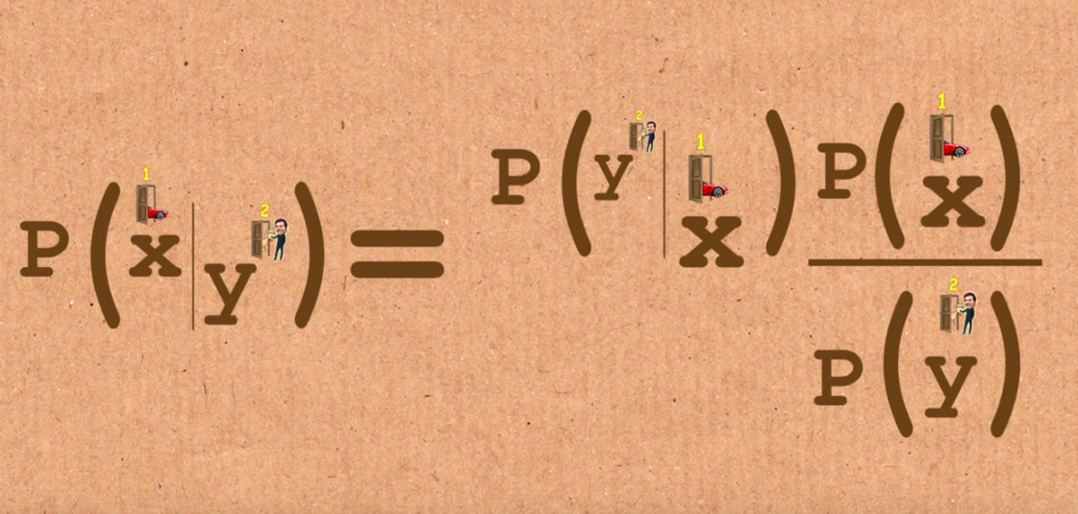
Bayes’ Rule:

Slide 12
Bayes Rule:
1/3
1/2
1/2

Slide 14
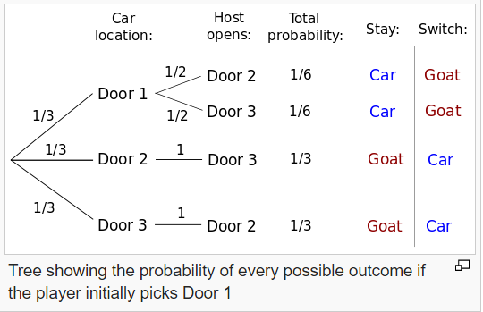
Probability tree

Slide 15
People have also validated this numerically (see Matlab code)
Movie “21”:
https://www.youtube.com/watch?v=Zr_xWfThjJ0

